Slide 1


The Holy Spirit
How the Spirit lives in us as Christians.
Acts 2:1-13; John 14:26-27,16:8; Galatians 5:22-23

Slide 2
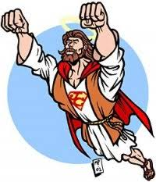
I KNOW THE HOLY SPIRIT
15 If ye love me, keep my commandments.
16 And I will pray the Father, and he shall give you another Comforter, that he may abide with you for ever;
17 Even the Spirit of truth; whom the world cannot receive, because it seeth him not, neither knoweth him: but ye know him; for he dwelleth with you, and shall be in you.
18 I will not leave you comfortless: I will come to you.
19 Yet a little while, and the world seeth me no more; but ye see me: because I live, ye shall live also.
•Before Jesus’ death, he promised that he and the Father would send to his disciples “another Helper” (John 14:15-27)

Slide 3
I KNOW THE HOLY SPIRIT
20 At that day ye shall know that I am in my Father, and ye in me, and I in you.
21 He that hath my commandments, and keepeth them, he it is that loveth me: and he that loveth me shall be loved of my Father, and I will love him, and will manifest myself to him.
22 Judas saith unto him, not Iscariot, Lord, how is it that thou wilt manifest thyself unto us, and not unto the world?
23 Jesus answered and said unto him, If a man love me, he will keep my words: and my Father will love him, and we will come unto him, and make our abode with him.
24 He that loveth me not keepeth not my sayings: and the word which ye hear is not mine, but the Father's which sent me.
25 These things have I spoken unto you, being yet present with you.
26 But the Comforter, which is the Holy Ghost, whom the Father will send in my name, he shall teach you all things, and bring all things to your remembrance, whatsoever I have said unto you.
27 Peace I leave with you, my peace I give unto you: not as the world giveth, give I unto you. Let not your heart be troubled, neither let it be afraid.
Helper means a person who provides encouragement, counsel and strength. Jesus promised a helper like himself.
The Holy Spirit is coequal with the Father and the Son. The Spirit acts as an individual person. Holy Spirit will speak, teach, witness and intercede.

Slide 4

THE GIFT OF THE HOLY SPIRIT
•THE HOLY SPIRIT IS PRESENT BOTH INSIDE US AND ON EARTH WITH US. BELIEVERS RECEIVE THE FULLNESS OF THE SPIRIT WHEN THEY ARE BAPTIZED.
•ACCORDING TO ACTS 2:38
UNTO THEM WHO REPENT AND BE BAPTIZED EVERY ONE OF YOU IN THE NAME OF JESUS CHRIST FOR THE REMISSION OF SINS, SHALL RECEIVE THE GIFT OF HOLY SPIRIT.

Slide 5
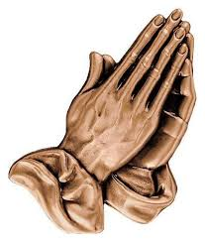

GROWING IN THE SPIRIT
SPIRITUAL GROWTH BEGINS WHEN KIDS CAN LEARN HOW THE HOLY SPIRIT CAN FIT INTO THEIR LIVES.
THE HOLY SPIRIT DOESN’T HAVE TO BE VISIBLE TO BE REAL.
THE COOLEST THING IS WHEN KIDS CAN GRASP THAT GOD KNEW WE WOULD NEED HELP BUT FORGET TO ASK.

Slide 6
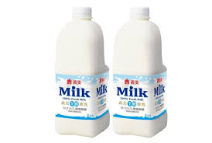

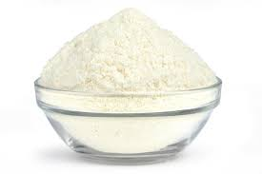
IT’S ALMOST LIKE A CAKE
EVEN THOUGH THE INGREDIENTS ARE NOT VISIBLE, WE KNOW THEY’RE STILL IN THE CAKE.
•FOR EXAMPLE; EGGS, MILK, AND FLOUR ARE INGREDIENTS FOR BAKING A CAKE. ONE THE INGREDIENTS ARE MIXED AND THE CAKE IS DONE. WHERE IS THE EGGS? THE MILK? THE FLOUR?
ONCE WE RECEIVE JESUS, CHOOSING TO BELIEVE IN AND FOLLOW HIM,THE HOLY SPIRIT IS WITHIN US. WE WILL NEVER BE THE SAME JUST AS THE INGREDIENTS WON’T BE THE SAME. BUT WE WILL BE MUCH, MUCH MORE.

Slide 7

IF YOU COULD SPEND ONE ENTIRE DAY DOING WHATEVER YOU WANT, WHAT WOULD YOU DO? HERE IS THE CATCH…YOU CAN’T USE A COMPUTER, TV, IPAD, OR CELL PHONE FOR THE ENTIRE DAY!
LET’S
ASK
GO AROUND THE CIRCLE AND HAVE EACH PERSON ANSWER THE FOLLOWING QUESTION:
QUESTION
A

Slide 8
WHAT DID JESUS PROMISE TO LEAVE US WHEN HE ASCENDED TO HEAVEN? JOHN 14:15-27
HOW DO YOU KNOW THERE IS OXYGEN IN THE AIR? JOHN 3:8
8 THE WIND BLOWETH WHERE IT LISTETH, AND THOU HEAREST THE SOUND THEREOF, BUT CANST NOT TELL WHENCE IT COMETH, AND WHITHER IT GOETH: SO IS EVERY ONE THAT IS BORN OF THE SPIRIT.
LET’S DISCUSS

Slide 9
• WHAT OTHER THINGS DO WE LET GUIDE US, BOTH NEGATIVE AND POSITIVE?
•WHAT ARE THINGS THAT DISTRACT US FROM GOD?
WHAT ARE SOME WAYS THAT GOD HAS GIVEN YOU GUIDANCE IN YOUR LIFE?
LET’S
DISCUSS

Slide 10
REMEMBER THIS
The Holy Spirit guides our path; sometimes it nudges and pushes us in directions we don’t feel comfortable going. When we allow Holy Spirit to work in our lives, this too will occur…life is best lived when we go the way God is leading you than to go against God.
Remember The Holy Counselor, Teacher, Comforter in times of need, Peace giver, Fills us with love and gives us guidance and words to say when we pray.

